Slide 1
Integers
FOR CLASS 6

Slide 2
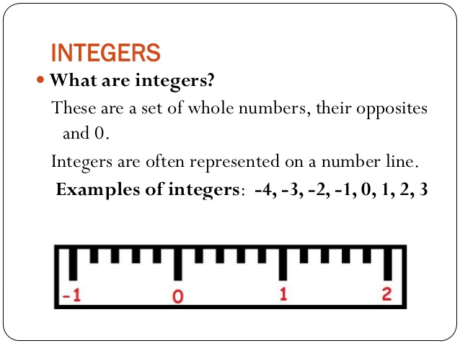

Slide 3
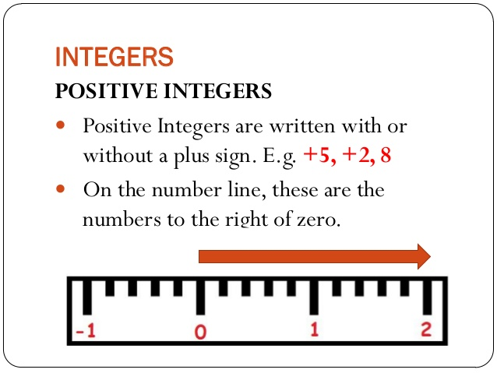

Slide 4
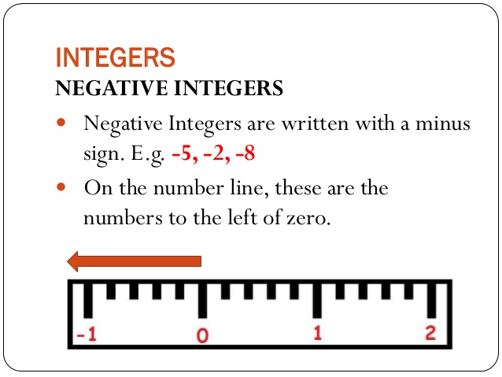

Slide 5
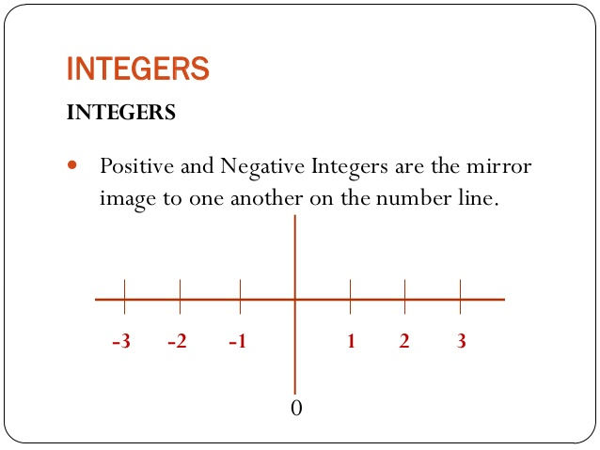

Slide 6
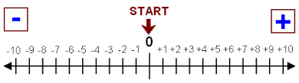
NUMBER LINE

Slide 7
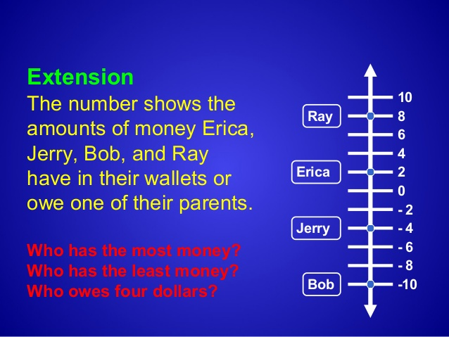

Slide 8
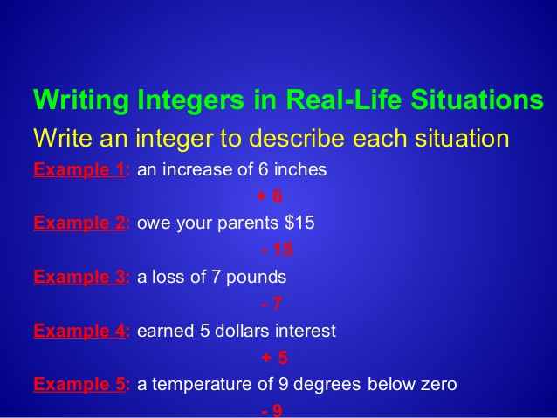

Slide 9


Slide 10
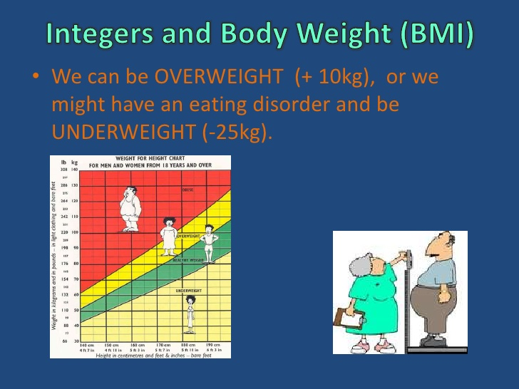

Slide 11

REAL LIFE EXAMPLES

Slide 12


Slide 13


Slide 14


Slide 15


Slide 16


Slide 17


Slide 18
Made by -
Madhu Saluja
Deepali Jain

